Slide 1


Interest Rate Risk Flow View
Case 1 C – Group 3
Financial Engineering

Slide 2
The real question for treasuries isn’t how much cash or cash flow they have today. It is how exposed that cashflow is to tomorrow’s uncertainty.

Slide 3
Presentation Roadmap
Our Goal is to help you understand, "How much cash flow risk can we accept, how to identify it, and what's the price to hedge it?"
The Challenge
Sources of Risk
What is Cash Flow at Risk?
Interest Rate Scenarios
Hedging Trade-offs
Calibration Choices
Recommendations
1
2
3
4
5
6
7

Slide 4
The Challenge
With rates more volatile than at any time in the past decade, treasurers face multiple challenges including refinancing at uncertain costs, absorbing higher floating debt expenses, and navigating unpredictable reinvestment opportunities.
These challenges can be categorized into
Uncertainty: Rate environment is more volatile than the past decade.
Complexity: Multiple exposures across different time horizons.
Planning: Budget cycles need probabilistic risk assessment.
Stakeholders: CFO & board demand clear, forward-looking communication.

Slide 5
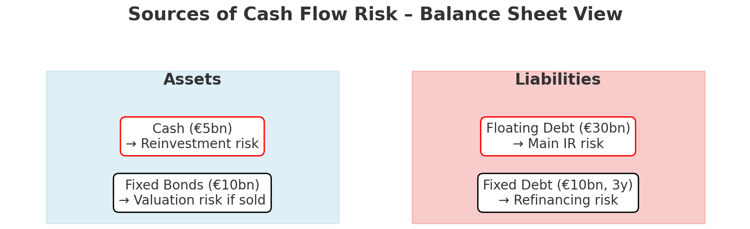
Where does cash flow volatility come from?
Revenue → FX exposure, demand risk, commodity-linked sales,
Operating Expenses → energy/raw material price volatility
Assets → cash (reinvestment risk), fixed bonds (market value risk), customer payment terms
Liabilities → floating-rate debt (Interest rate exposure), fixed-rate debt (refinancing risk), supplier payment terms
A Reference Example

Slide 6
Concept of Cashflow at Risk
CFaR or Cash Flow at Risk measures the potential adverse impact on future cash flows due to interest rate movements over a specific time horizon at a given confidence level.
$$CFaR_{α}=Expected Cash Flow − Worst Case Cash Flow (at α level)= {E\left(CF\right)−Q}_{\left\{α\right\}}\left(CF\right)$$
Where : α = confidence level (e.g., 95%); Q = quantile of cash flow distribution
Lets understand this with a simple question,
“What if interest rates suddenly rise by 1% — how much more will our company pay in interest?”
$$CFaR_{\left\{95\%\right\}}=E\left(CF\right)−Q_\{95\%\}(CF | Δr = 1\%)$$
Where : r = Interest Rate; Δr = 1% (Interest rate increase)

Slide 7
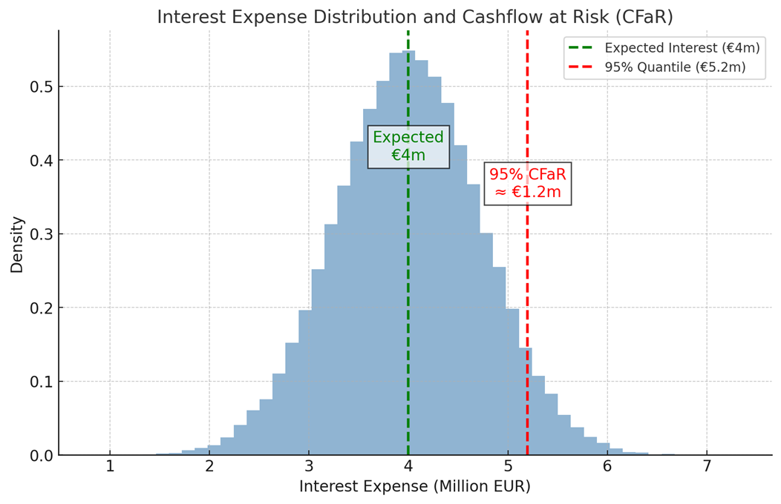
One Simple Example
Let’s assume a floating loan of notional € 100 M
Expected interest at 4% = €4m
Let's say that after simulating multiple interest rate change scenarios, we find that With 95% probability, annual interest expense will not exceed €5.2m. In 5% of cases, it could be higher
“With 95% confidence, interest expense will not exceed €5.2m, which is still €1.2m worse than the budget”
This is not just an abstract number. It tells the treasurer: keep at least €1.2m of additional liquidity in reserve or consider hedging

Slide 8
Advantages & Disadvantages
Approach
Advantages
Disadvantages
Difference vs. CFaR
Duration/Convexity
Simple, intuitive measure of interest rate sensitivity
Ignores distribution and tail risk
CFaR captures full distribution in cash and tail risk, not just sensitivity
Value at Risk (VaR)
Widely used, regulator-recognized, strong comparability
Focuses on portfolio value rather than liquidity
CFaR focuses on liquidity and budget certainity
Earning at Risk (EaR)
Linked to accounting earnings, aligns with financial statements
May underestimate liquidity stress
CFaR highlights cashflow pressure beyond reported earnings
Scenario/Stress test
Flexible, easy to communicate “what-if” stories
Depend on assumptions, no probability meaning
CFaR provides a probabilistic, confidence-level based risk measure
CFaR Pros
Dollarized measure: Expressed directly in cash (extra potential outflow)
Liquidity-centric
Probabilistic Measure
Captures market risk drivers (rates, FX, etc)
CFaR Cons
Model and calibration dependent
Data Heavy
Not regulator-standardized

Slide 9
Why Cash Flow at Risk Matters
Multiple exposures, different timings, various risk types → We need integrated measurement
Each risk source creates unique uncertainty in future cash inflows/outflows.
Traditional tools like duration, sensitivities, and simple shocks provide useful but partial views — they don’t capture probabilities.
CFaR, like VaR, is a probabilistic measure but focused on future cash flows instead of portfolio values.
CFaR integrates everything into one probabilistic metric: “With 95% confidence, net cash flows will not be worse than €X.”

Slide 10
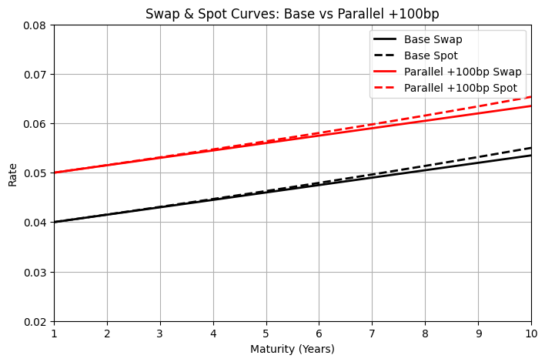
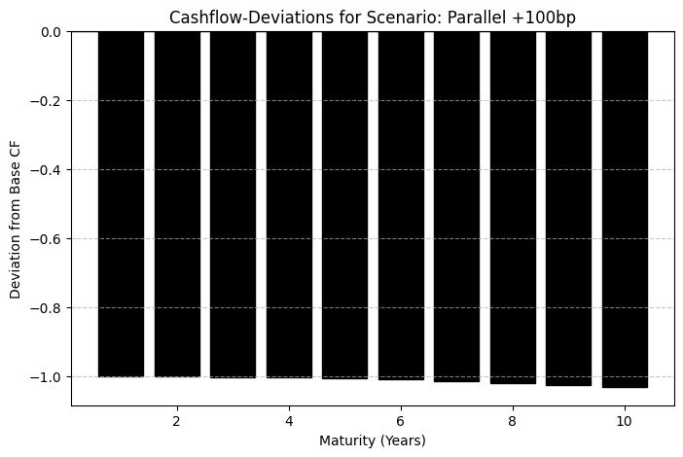
Interest Rate Scenario 1: Parallel +100bp
Cash Flow Impact on the Asset Side
Cash Flow Impact on the Liability Side
Higher interest income from floating-rate investment
Higher interest expense for floating-rate liabilities
Higher interest income for investment rollover
Higher interest expense for refinancing
Decreased value of fixed-rate investment, no cash flow impact
No cashflow impact from value depreciation of fixed-rate liabilities
Direction of net cashflow effect depending on Asset/Liability sensitivity

Slide 11
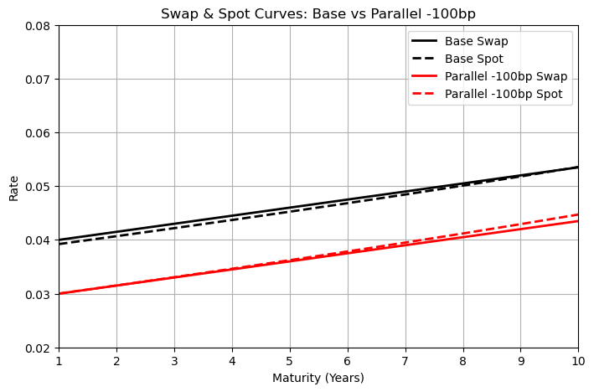
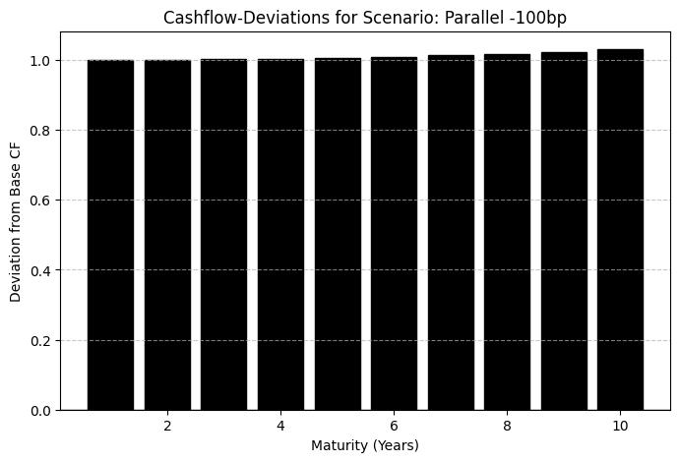
Interest Rate Scenario 2: Parallel - 100bp
Cash Flow Impact on the Asset Side
Cash Flow Impact on the Liability Side
Lower interest income from floating-rate investment
lower interest expense for floating-rate liabilities
Lower interest income for investment rollover
Lower interest expense for refinancing
Increased value of Long-Term investment, no cash flow impact
No cashflow impact from value appreciation of fixed-rate liabilities
Direction of net cashflow effect depending on Asset/Liability sensitivity

Slide 12
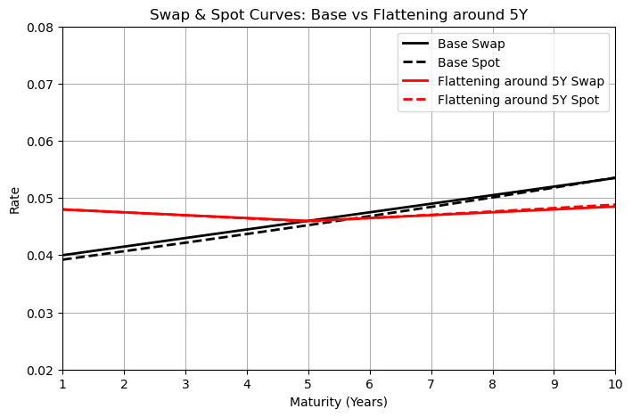
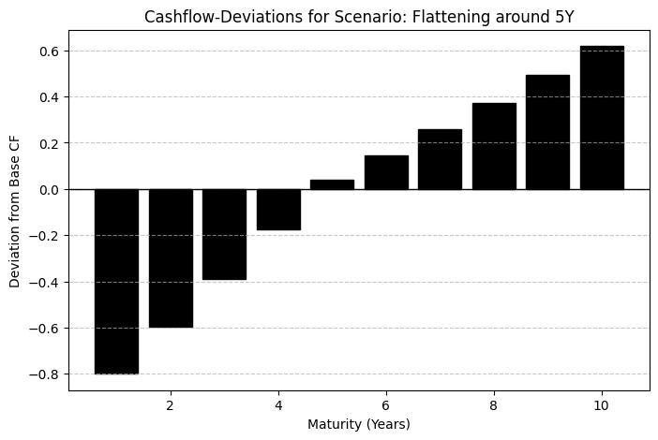
Interest Rate Scenario 3: Flattening the Curve Around 5Y
Cash Flow Impact on the Asset Side
Cash Flow Impact on the Liability Side
Higher interest income from Short-Term investment
Higher interest expense for Short-Term liabilities
Higher interest income for investment rollover
Lower interest expense for Long-Term refinancing
Increased value of Long-Term investment, no cash flow impact
No cashflow impact from value appreciation of Long-Term liabilities
Positive net cashflow effect given Short-Term Asset and Long-Term Liabilities

Slide 13
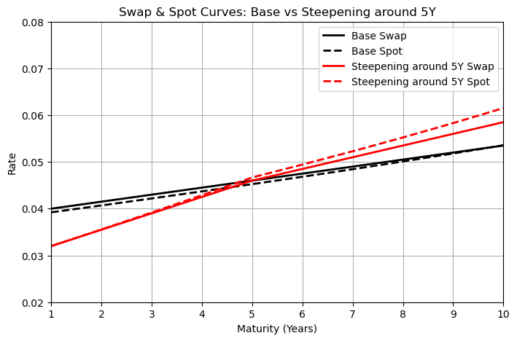
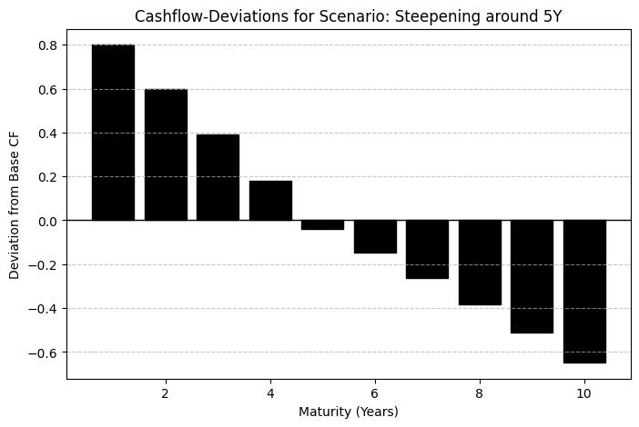
Interest Rate Scenario 4: Steepening the Curve Around 5Y
Cash Flow Impact on the Asset Side
Cash Flow Impact on the Liability Side
Lower asset-side interest income from Short-Term investment
Lower interest expense for Short-Term liabilities
Lower interest income for investment rollover
Higher interest expense for Long-Term refinancing
Decreased value of Long-Term investment, no cash flow impact
No cashflow impact from value depreciation of Long-Term liabilities
Negative net cashflow effect given Short-Term Asset and Long-Term Liabilities

Slide 14
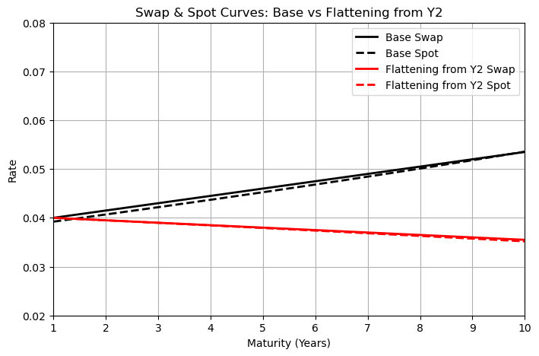
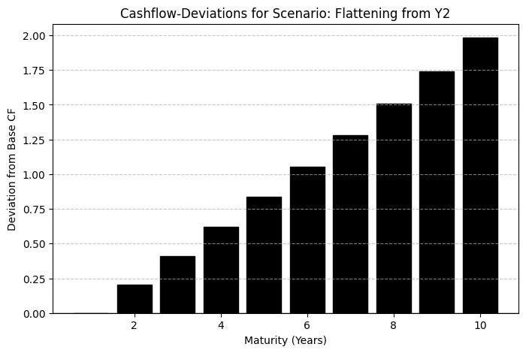
Interest Rate Scenario 5: Flattening the Curve Around 2Y
Cash Flow Impact on the Asset Side
Cash Flow Impact on the Liability Side
Unchanged interest income from Short-Term investment
Unchanged interest expense for Short-Term liabilities
Decreased interest income for investment rollover
Lower interest expense for Long-Term refinancing
Increased value of Long-Term investment, no cash flow impact
No cashflow impact from value depreciation of Long-Term liabilities
Positive net cashflow effect given more pronounced impact on the long-term rate

Slide 15
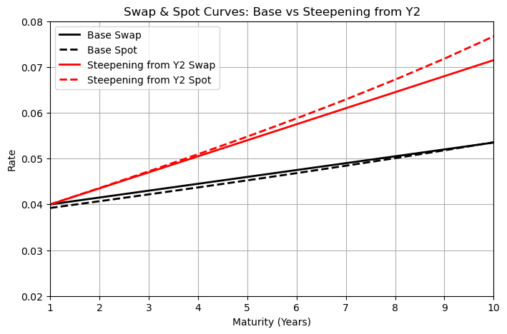
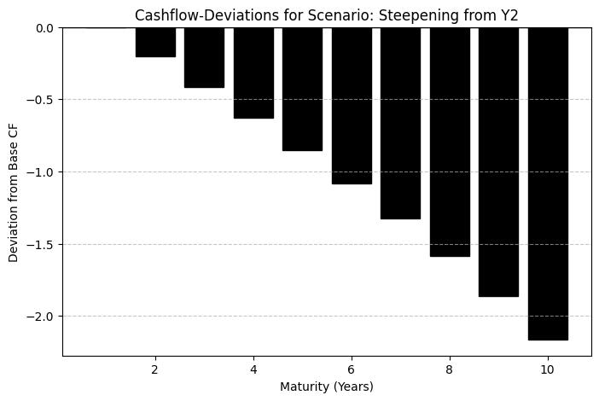
Interest Rate Scenario 6: Steepening the Curve Around 2Y
Cash Flow Impact on the Asset Side
Cash Flow Impact on the Liability Side
Unchanged interest income from Short-Term investment
Unchanged interest expense for Short-Term liabilities
Increased interest income for investment rollover
Higher interest expense for Long-Term refinancing
Decreased value of Long-Term investment, no cash flow impact
No cashflow impact from value depreciation of Long-Term liabilities
Negative net cashflow effect given more pronounced impact on the long-term rate

Slide 16
Cash Flow at Risk Across Maturities
We assume one line item from the balance sheet, 100 Mio outstanding floating rate debt
Maturity (Years) | Expected CF (Base) | Parallel +100bp | Parallel -100bp | Flattening around 5Y | Steepening around 5Y | Flattening from Y2 | Steepening from Y2 | CFaR_95
1 | -3.922071315 | -5 | -3 | -4.8 | -3.2 | -4 | -4 | -1.027928685
2 | -4.06919105 | -5.153868231 | -3.152366022 | -4.748813087 | -3.556234132 | -3.949012989 | -4.357638958 | -0.983413395
3 | -4.218476647 | -5.31077314 | -3.306674615 | -4.696833049 | -3.918508091 | -3.897377295 | -4.72234908 | -0.945190478
4 | -4.370247768 | -5.471108868 | -3.463229221 | -4.644061212 | -4.288441187 | -3.845102439 | -5.095862372 | -1.007049476
5 | -4.524859296 | -5.635319649 | -3.6223628 | -4.590501233 | -4.667888811 | -3.792200038 | -5.480189759 | -1.07167788
6 | -4.682708351 | -5.803909806 | -3.784443815 | -4.648165745 | -4.94320416 | -3.738683855 | -5.877712674 | -1.176553606
7 | -4.844242854 | -5.977456136 | -3.949883432 | -4.706045337 | -5.227705117 | -3.684569829 | -6.291307077 | -1.368601488
8 | -5.009972074 | -6.156623411 | -4.11914427 | -4.764537945 | -5.522691947 | -3.629876096 | -6.724515962 | -1.57257075
9 | -5.18047979 | -6.342184007 | -4.292751167 | -4.82390701 | -5.829878615 | -3.574622991 | -7.181796156 | -1.791413329
10 | -5.356440879 | -6.53504306 | -4.471304583 | -4.884353307 | -6.151431422 | -3.518833035 | -7.6688822 | -2.028981535
"At 1-year maturity, 95% CFaR = €1m. Meaning our annual interest cost could be €5m instead of €4m. Treasury must plan an extra €1m liquidity buffer."

Slide 17
Hedging Strategy Analysis
Strategy Type
Basic Mechanism
CFaR Impact
Cost Strcture
Interest Rate Swap
Exchange floating-rate payments for fixed-rate payments
Reduces CFaR volatility
Fair value at inception
Interest Rate Cap
Provides protection when rates exceed the strike
Asymmetric CFaR protection
Premium payment required
Interest Rate Collar
Combination of cap and floor
Balanced CFaR reduction
Reduced or zero net premium
Flexibility vs. Protection Trade-off
Decision Matrix for Hedging Instruments
CFaR Reduction
Swap
Collar
Cap
Cost

Slide 18
Calibration Choices: Tailoring CFaR to Treasury Governance
Time Horizon
1 Year: aligns with annual budget cycle, liquidity buffer sizing.
3–5 Years: captures refinancing and strategic debt mix.
Confidence Level
95% vs 99% Level: planning vs conservative buffer
Methodology
Deterministic scenarios
Historical simulation
Monte Carlo
Market Inputs
Swap curve: neutral market baseline
Forward rates: market expectations
Internal forecasts: Budget inputs
"Calibration makes CFaR flexible. By adjusting horizon, confidence, methodology, and inputs, the metric can be tailored to treasury governance and board risk appetite”

Slide 19
CFaR – A tool and a framework
CFaR is both a tool and a framework — it gives treasury an actionable liquidity risk number today, and a governance process to manage interest rate risk going forward
Liquidity focus: quantifies worst-case cash shortfall, not mark-to-market swings
Board-ready metric: simple output in € terms (95% confidence, 12m horizon)
Decision support: evaluates hedging trade-offs (hedged vs unhedged)
Governance alignment: ties risk reporting to board appetite and rating agency expectations

Slide 20
Recommendation
Model Configuration:
Time Horizon: 12-month primary horizon with quarterly updates
Confidence Level: 95% for management reporting, 99% for a more conservative view
Scenario Framework: Equal weighting of all 6 scenarios as baseline approach
Update Frequency: Monthly CFaR calculation with quarterly model recalibration
Calibration Recommendations:
Start Simple: Begin with basic scenario analysis before advanced modeling
Focus on Material Exposures: Prioritize largest interest rate exposures
Validate Regularly: Quarterly backtesting against actual outcomes
Document Assumptions: Clear audit trail for all model parameters

Slide 21







Team
Ying Liu
8513629
Abdul Malik
8512905
Marco Leibersperger
8518121
Ritesh Kumar
8510249
Shangrun Jiang
8501084
Mujtaba Ali Bhutto
8513611
Chang Liu
8514049

Slide 22
Thank you !

